Slide 1
Secure Data Hiding in Images Using Steganography
CAPSTONE PROJECT
Presented By: Yash Nitin Pathak
Student Name : Yash Nitin Pathak
College Name & Department : St. Vincent Pallotti College of Engineering and Technology & Information Technology

Slide 2
OUTLINE
Problem Statement
Technology used
Wow factor
End users
Result
Conclusion
Git-hub Link
Future scope

Slide 3
Problem Statement
Data security is a critical concern in today's digital world. Traditional encryption methods provide security but may attract attention from hackers. Steganography offers a way to hide sensitive data within images, making the hidden information less detectable. This project focuses on securely embedding and extracting data using steganographic techniques.

Slide 4
Technology used
Programming Language: Python
Libraries: OpenCV
Platform : VS Code
Concepts: Steganography

Slide 5
Wow factors
High Security: Conceals data within images, making it difficult to detect.
Minimal Data Alteration: The image appears unchanged to the human eye.
Lightweight & Efficient: Uses LSB method to embed data efficiently without noticeable distortion.

Slide 6
End users
Cybersecurity Professionals
Government & Defense Agencies
Journalists & Whistleblowers
Secure Communication Users

Slide 7
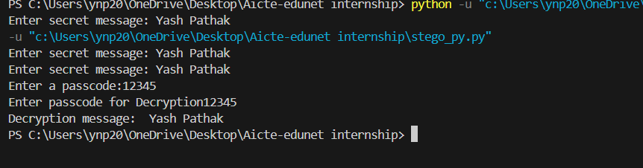
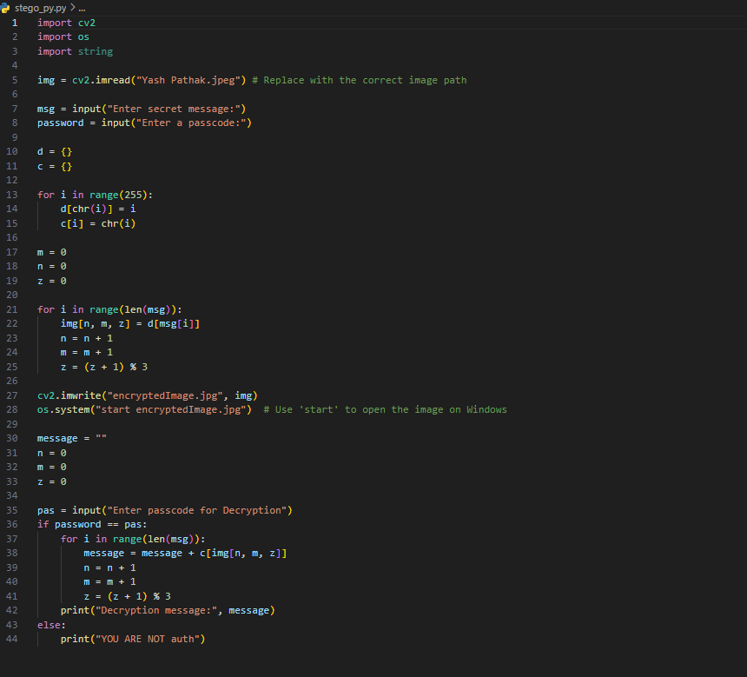

Results
Output
Encrypted image output
Code

Slide 8
Conclusion
Steganography provides an effective method for secure data transmission without raising suspicion. This project successfully demonstrates data embedding and extraction within images using LSB steganography. Future enhancements could involve encryption before embedding to increase security further.

Slide 9
GitHub Link
https://github.com/yashpathak1903/Aicte-Edunet-Internship-Project

Slide 10
Future scope(optional)
Implementing encryption before embedding data
Enhancing security using deep learning-based steganalysis detection
Exploring other steganographic techniques such as frequency-domain methods

Slide 11
THANK YOU

